Slide 1


MISSION 4:
Differentiate the seismic waves;
B. illustrate the motion of waves;
C. explain how earthquake wave provide information about the interior of Earth.
START
FINAL STAGE
HOME

Slide 2

Hi Friends!
I’m glad you’re here again.
I am excited to learn new things again.
You’ll be surprise who will help us today in our journey.

Slide 3


First, discover the different earthquake waves and differentiate each.
Hey kid it’s me again Ram the Troll .
Now I am here to help you unlock the final mission.
Find out how earthquake wave provide information about the features of the Earth’s interior.

Slide 4

STAGE 1: Guess what!
QUESTION 1. Click your answer below
These seismic waves are detected, measured, and recorded by an instrument
SEISMOGRAPH
SEISMOGRAM
SEISMOMETER

Slide 5
NICE TRY
THINK AGAIN

Slide 6
STAGE 1: Guess what!
QUESTION 2. Click your answer below
The data are recorded in seismograph as zigzag lines ?
Seismogram
Seismometer
Seismic waves

Slide 7
NICE TRY
THINK AGAIN

Slide 8
STAGE 1: Guess what!
QUESTION 3. Click your answer below
It is a SURFACE WAVES that travel like ripples in water. They have slow velocity and lower in intensity as compared to body waves.?
L waves
P waves
S waves

Slide 9
NICE TRY
THINK AGAIN

Slide 10
STAGE 1: Guess what!
QUESTION 4. Click your answer below
What are the different layer of the interior of Earth?
Atmosphere, Lithosphere, asthenosphere
Crust, Mantle , Core
None of the above

Slide 11
a
NICE TRY
THINK AGAIN

Slide 12
STAGE 1: Guess what!
QUESTION 5. Click your answer below
A body waves also called shear waves?
L wave
P wave
S wave

Slide 13
a
NICE TRY
THINK AGAIN

Slide 14
As the rocks slip and slide, the stored energy is released from the focus in all directions in the form of seismic waves. These seismic waves are detected, measured, and recorded by an instrument called seismograph. The data are recorded as zigzag lines called seismogram.

Slide 15
The Different Types of Seismic Waves
There are two main types of seismic waves: the surface waves and the body waves. They are characterized according to velocity and their effect on rock masses.
The primary (P- wave) and secondary (S- wave or shear waves) waves are called body waves because they travel within the Earth‘s interior. They can provide scientists with information as regards the nature and composition of the Earth’s interior. Both P- and S- waves produce a sharp jolt or shaking of the ground. They likewise enable seismologists to locate the focus and epicenter of an earthquake.
Surface Waves, also called L –Waves, travel like ripples in water. They have slow velocity and lower in intensity as compared to body waves.

Slide 16
The Characteristics of the Three Types of Seismic Waves
Study and analyze well the given table.
You will need the information here to pass the next stage.
Best of Luck!
Primary Waves | Secondary Waves | Surface Waves
Travel in all types of media (solid,liquid,and gas). | Travel only in solids | Travel on the surface or the ground
First to be recorded by a seismograph | Second to be recorded by a seismograph | Last to be recorded by a seismograph
Can cause the alternative contraction and expansion of bedrock,causing the volume of the material where they travel to change and for the material to move back and forth like an accordion. | Can cause the particles of the material where they pass through to move in a perpendicular(up and down or side to side)direction. | Can cause the swaying motion of the ground causing the surface to behave like waves in the ocean
Use your periodic table.

Slide 17

STAGE 2:
Which is Which
Mission:
Differentiate the seiemic waves
by identifying their properties
START

Slide 18
a
STAGE 2 : HUNTER’S CAMP
Make sure that you read and analyze the statement before you CLICK the answer.
I will show you different description that describe p waves and s waves.

Slide 19

L waves
P waves
S waves
1. Second to be recorded by a seismograph

Slide 20

Click here
TRY AGAIN

Slide 21
L waves
P waves
S waves
2. Travel on the surface or the ground.

Slide 22
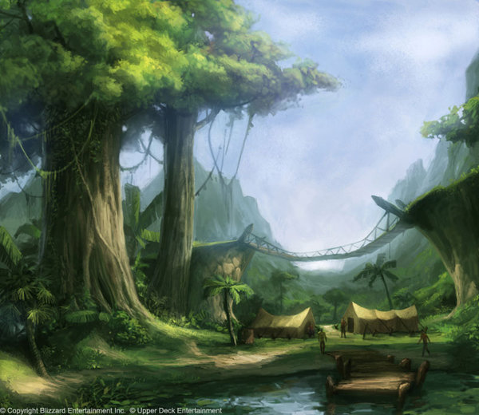
Click here
TRY AGAIN

Slide 23
L waves
P waves
S waves
3. Travel in all types of media
(solid,liquid, and gas).

Slide 24
Click here
TRY AGAIN

Slide 25
L waves
P waves
S waves
4. First to be recorded by a seismograph

Slide 26
Click here
TRY AGAIN

Slide 27
L waves
P waves
S waves
5. Can cause the particles of the material where they pass through to move in a perpendicular(up and down or side to side)direction.

Slide 28
Click here
TRY AGAIN

Slide 29
L waves
P waves
S waves
6. Travel only in solids

Slide 30
Click here
TRY AGAIN

Slide 31
L waves
P waves
S waves
7. Can cause the swaying motion of the ground causing the surface to behave like waves in the ocean.

Slide 32
Click here
TRY AGAIN

Slide 33
L waves
P waves
S waves
8. Can cause the alternative contraction and expansion of bedrock, causing the volume of the material where they travel to change and for the material to move back and forth like an accordion.

Slide 34
Click here
TRY AGAIN

Slide 35
L waves
P waves
S waves
9. Last to be recorded by a seismograph.

Slide 36
Click here
TRY AGAIN

Slide 37
L waves
P waves
S waves
10.They have slow velocity and lower in intensity as compared to body waves

Slide 38
Click here
TRY AGAIN

Slide 39


I can’t believe it .
Amazing ! But...
you’re still in the middle of the mission.
You better win this round hehehe.

Slide 40
BRAIN BLAST
let us observe the motion of waves and explain how earthquake wave provide information about the interior of Earth.
Now that you know what are the characteristic of each type of seismic waves ,

Slide 41
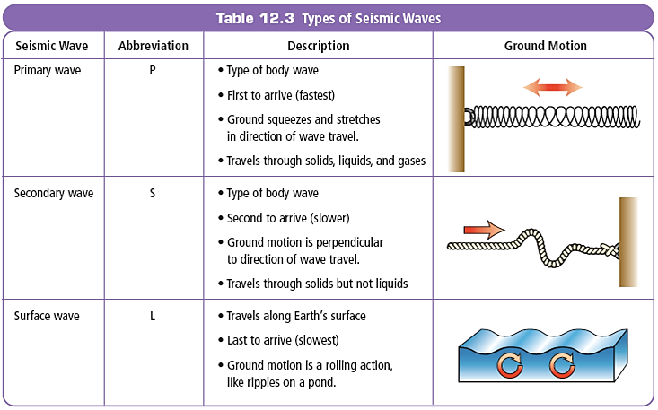

Slide 42
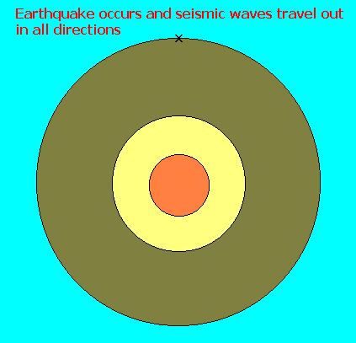
How earthquake wave provide information about the interior of Earth?
Earthquake waves emanating from the focus or hypocenter travel in different directions and at different.
Crust is the part of the earth in which the seismic waves speed up.
The velocity of Secondary or s waves STOPS when it reaches the partially molten regions of the mantle.
The two major types of seismic waves, the body waves play an important role in providing scientists with information about the nature and composition of the earth’s interior.
*The mantle is composed of materials that have been elastic due to extreme pressure.
This is because seismologists observed that the velocities of the P- and S- waves had increased abruptly as they passed through the mantle.
Seismologists observed that the seismic waves are continually being refracted or bent along curved paths as they travel through the earth’s interior.
*The earth’s interior is composed of materials of varying densities.
*The outer core is liquid in form. This is because the velocity of S – waves had gone to zero when it reached the outer core.
Considering that S – waves shear materials as they pass through, their disappearance indicates that the material composing the outer core is liquid because liquid materials lack rigidity.

Slide 43
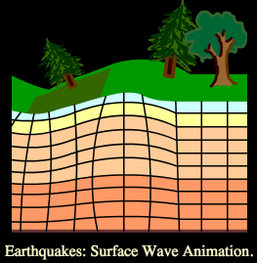

P wave
What type of wave is travelling in the direction of the arrow?
Can you describe the motion of S wave?
Can you describe the motion of L wave?
S wave
L wave

Slide 44

Good job everyone!
You are now ready for Master Yul’s Final Stage!

Slide 45


FINAL STAGE:
MASTER YUL
HOME
START

Slide 46

DIRECTION: Multiple Choice Read and analyze the questions and choose the correct answer.

Slide 47

STAGE: MASTER
STAGE: MASTER
1. Of the three types of earthquake waves, which causes the most damage?
a. P wave c. L waves (Surface wave)
b. S wave

Slide 48
STAGE: MASTER
2. This instrument detect and measure earthquake waves?
Barometer
seismogram
seismograph

Slide 49
STAGE: MASTER
3. What part of the earth in which the seismic waves speed up?
a. crust
b. mantle
c. core

Slide 50
STAGE: MASTER
4. What would happen to the velocity of Secondary or s waves when it reaches the partially molten regions of the mantle?
a. stops
b. proceed to the core
c. go back to crust

Slide 51
STAGE: MASTER
5. ) Which earthquake waves travel
through solid rocks and fluids like water or the liquid layer of the Earth?
P waves only
P and S waves
c. P and surface waves only
d. P waves, S waves and surface waves

Slide 52

ANSWERS
C L-waves
C seismograph
3. A crust
4. B. Proceed to the core
5. A P waves only

Slide 53



You win this time.
Here is the 4th treasure.
OPEN THIS
TREASURE OF PREPAREDNESS

Slide 54


CONGRATULATIONS
HOME

Slide 55
MISSION 5: Last Chapter
A. Identify the thing to consider before , during and after an earthquake occurred.
B. Make emergency plan and prepare an emergency kit.
C. Infer the importance of being prepared in times of disaster .
START
FINAL STAGE
HOME

Slide 56



What are the things we should do?
Oh no an earthquake is happening now.
Let us be observant on our environment now a days!
Hi everyone!
MEV THE EXPLORER

Slide 57




A
B
C
D

Slide 58
Thanks for telling me what to do.
Why in times of disaster like Earthquake we need to be prepared?
This time we can use all the given treasures we collect in each mission we encounter.

Slide 59

I challenge you if you can survive my last attack.
Your mission is to identify the things you must consider before , during and after an earthquake .

Slide 60
STAGE 1: Discovery Time
QUESTION 1. Click your answer below
What must you consider before an earthquake?
Prepare a 72 hour survival kit
Duck , Cover, Hold

Slide 61
NICE TRY
THINK AGAIN

Slide 62
FLASHLIGHT
Arrange the jumbled letter to identify the things inside the 72 hour survival kit bag.
QUESTION 2. Click your answer below
What are the things to prepare in 72 hour survival kit?
IGHFLLASHT

Slide 63
WATER
QUESTION 2. Click your answer below
What are the things to prepare in 72 hour survival kit?
RETAW

Slide 64
MONEY
QUESTION 2. Click your answer below
What are the things to prepare in 72 hour survival kit?
YENOM

Slide 65
MEDICINE
QUESTION 2. Click your answer below
What are the things to prepare in 72 hour survival kit?
DICMEINE

Slide 66
BATTERIES
QUESTION 2. Click your answer below
What are the things to prepare in 72 hour survival kit?
TERBATIES

Slide 67
IMPORTANT DOCUMENTS
QUESTION 2. Click your answer below
What are the things to prepare in 72 hour survival kit?
IRTAMPONT MENTDOCUS

Slide 68
READY TO EAT FOOD
QUESTION 2. Click your answer below
What are the things to prepare in 72 hour survival kit?
ADREY TO ATE FDOO

Slide 69
CLOTHES
QUESTION 2. Click your answer below
What are the things to prepare in 72 hour survival kit?
THECLOS

Slide 70
WHISTLE
QUESTION 2. Click your answer below
What are the things to prepare in 72 hour survival kit?
STLWHIE

Slide 71
RADIO
QUESTION 2. Click your answer below
What are the things to prepare in 72 hour survival kit?
ADRIO

Slide 72
CELLPHONE
QUESTION 2. Click your answer below
What are the things to prepare in 72 hour survival kit?
CEPHOLLNE

Slide 73
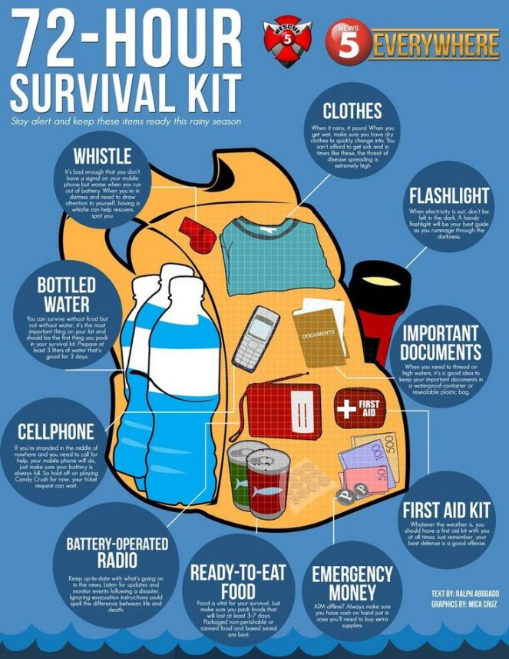
Please get some pictures of while you are doing this together with each of your family members and post it to share awareness.
Those materials must consider in your 72 hours survival bag , can you still recall it one by one?.
Now we know what must inside our 72 hours survival bag .
We must prepare now for each member of our family.

Slide 74
Do you know Emergency Exit Floor Plan at your area ?
Aside from this , can you give other things to consider before an earthquake may occur?
We also need to know the local emergency hotline in our community .
Can you give me emergency hotline on your area ?

Slide 75
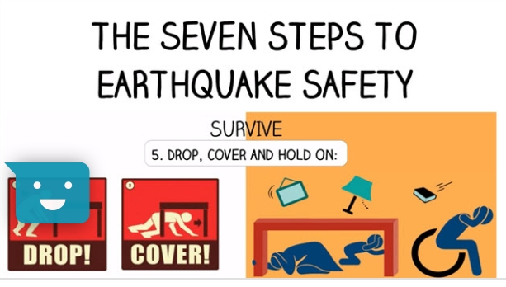

Slide 76
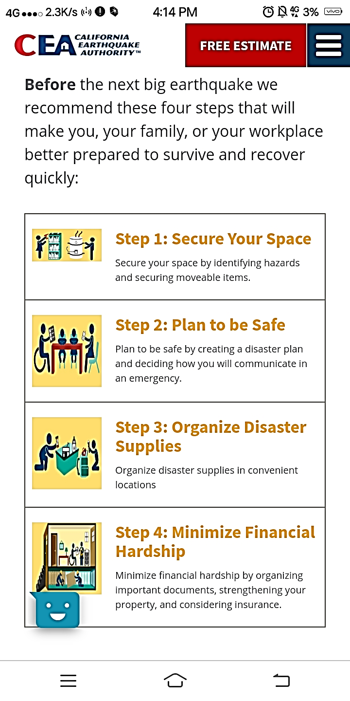
BRAIN BLAST

Slide 77
How about the things to remember DURING AN EARTHQUAKE?

Slide 78
What does the pictures tell us to do DURING an earthquake?
Be alert but don’t PANIC when we encounter earthquake .
We must look for strong object that can protect us from falling things.

Slide 79
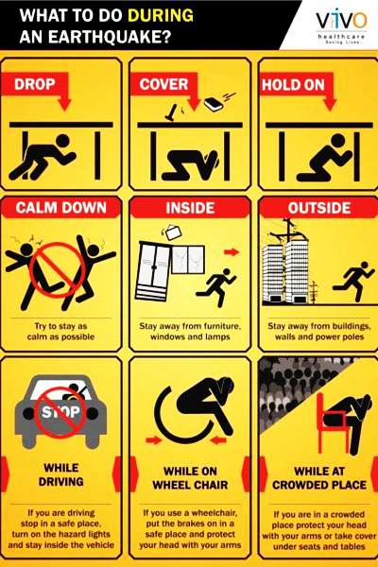
Try to identify what does the picture tell us to do DURING an earthquake?
1
2

Slide 80
Try to identify what does the picture tell us to do DURING an earthquake?
4
3

Slide 81
Try to identify what does the picture tell us to do DURING an earthquake?
6
5

Slide 82
Can you tell me again the things to do during an earthquake?
You’re really great.

Slide 83
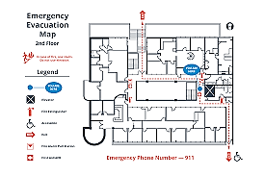
Do you know Emergency Exit Floor Plan at your school?
Do you have an Emergency Exit Floor Plan at home?
For your special mission is you need to make a EMERGYNCY EXIT FLOOR PLAN at your home and show it to your family members.
Remember to use labels and think of the safest and fastest way to escape.

Slide 84
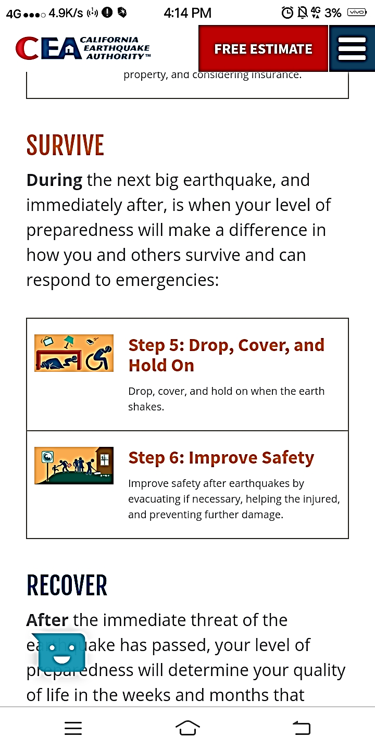

Slide 85
Can you survive this round? hehehehe
I will show you different pictures that we can remember after an earthquake.
I challenge you to identify this one by one.

Slide 86
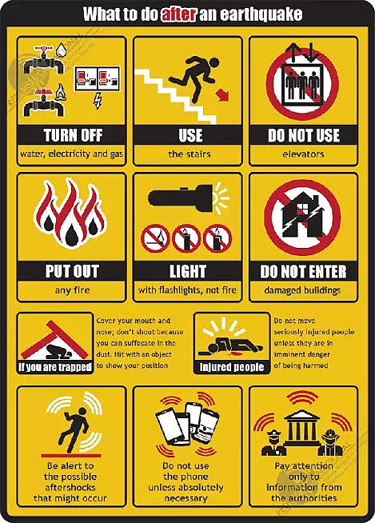
Try to identify what does the picture tell us to do AFTER an earthquake?
1
2

Slide 87
What does the picture tell us to do AFTER an earthquake?
3
4

Slide 88
What does the picture tell us to do AFTER an earthquake?
6
5

Slide 89
What does the picture tell us to do AFTER an earthquake?
8
7

Slide 90
Can you tell me again the things to do after an earthquake?
You’re really awesome.

Slide 91
This are some things to consider after an earthquake. Do you think it is important to know ? Why?

Slide 92
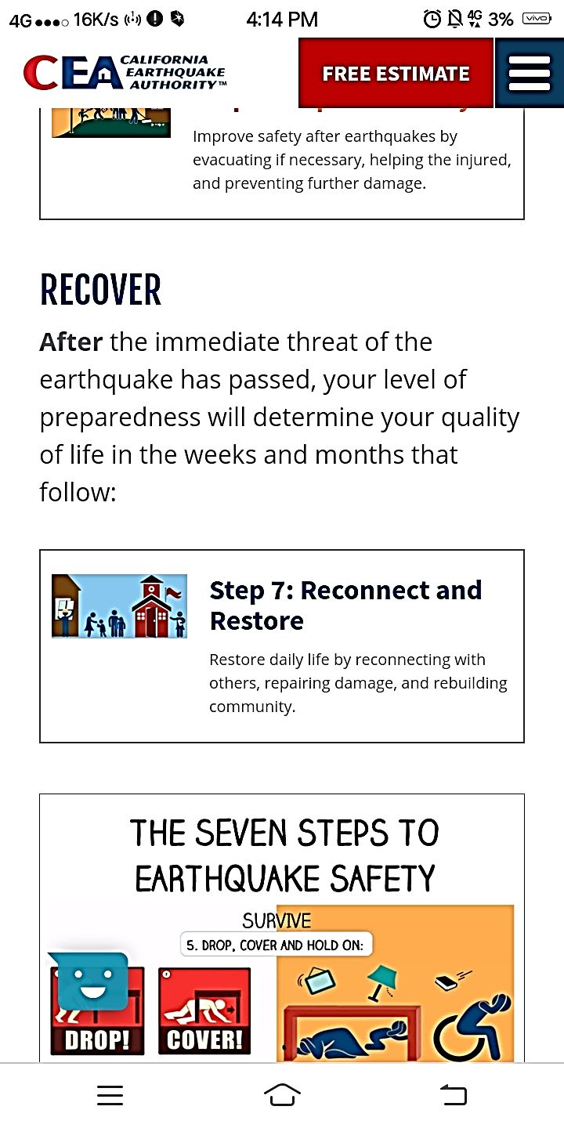

Slide 93
Wow! That’s great to hear.
And I hope everyone will also be prepared in times of disaster to lessen the possible damage that will occur .
What do you think is the objective of Disaster Risk Reduction Management or DRRM in school?
Can you share some best practices you do at school which helps you to be prepared when a disaster occurred?
How about at your home, can you share your best DRRM practices?

Slide 94
KNOWLEDGE
Can you still recall all the treasures we gather in each stages?
AWARENESS
CALMNESS
ALERTNESS
BRAVERY
PREPAREDNESS

Slide 95
This are the special powers we can use in times of disaster.

Slide 96
FINAL STAGE:
MASTER YUL
HOME
START

Slide 97
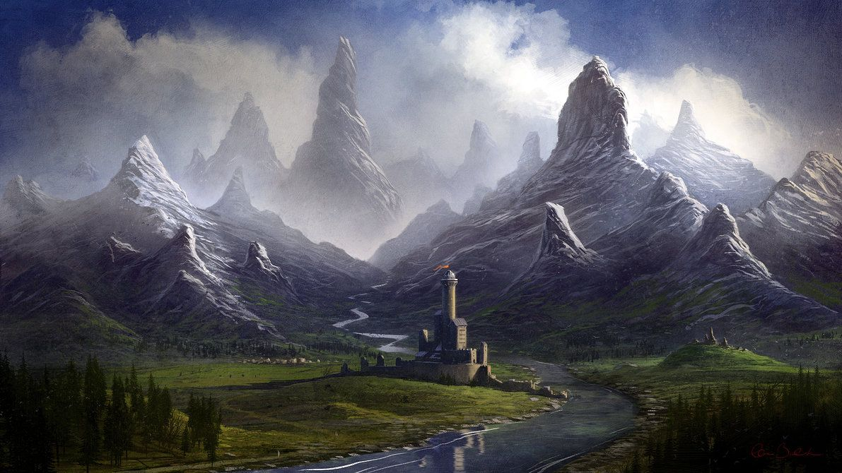
FINAL STAGE 3: Master Level
Direction: Identify the pictures if it is shows things to consider BEFORE, DURING or AFTER
an earthquake.
BEFORE
DURING
AFTER

Slide 98
FINAL STAGE 3: Master Level
BEFORE
DURING
AFTER

Slide 99
FINAL STAGE 3: Master Level
BEFORE
DURING
AFTER

Slide 100
FINAL STAGE 3: Master Level
BEFORE
DURING
AFTER

Slide 101

FINAL STAGE 3: Master Level
BEFORE
DURING
AFTER

Slide 102
ANSWERS
AFTER
DURING
3. BEFORE
4. BEFORE
5. DURING

Slide 103

You’re really awesome .
Here is last treasure.
OPEN THIS
TREASURE OF SURVIVAL

Slide 104

CONGRATULATIONS
THE END
REFERENCES: Slip Faults (miamioh.edu)
miedie pop-ups 4 examples with gif - Bing images Quest:Big Game Hunter (old) | WoWWiki | Fandom
Funny Monkey 12 – LINE stickers | LINE STORE Earth Layers | Baamboozle - Baamboozle | The Most Fun Classroom Games!
FUTURE PROGRESSIVE TENSE exercise | Live Worksheets Adventures in 3D - part 2 by Shabello on Dribbble
Funny Monkey ver.2 – LINE stickers | LINE STORE k5 bouncecore gif - Bing images
Torall Giant - Apps on Google Play Tarheel Writer - Gay stories, original and suggested.
digital Art, Valley, Statue, Mountain, Fantasy Art Wallpapers HD / Desktop and Mobile Backgrounds (wallup.net) Secrets of Stranglethorn Vale - Hearthstone (blizzard.com)
Mississippi River ran backward 1812, maps (showme.net) Earth’s Layered Structure - ppt video online download (slideplayer.com)
princess poppy trolls - Google Search Iris Earthquake GIF by EarthScope Consortium - Find & Share on GIPHY
Living-Safely-with-Natures-Hazards.pdf (pagba.com) 2.2 active faults & other earthquakes source zones | PPT (slideshare.net) 2.2 active faults & other earthquakes source zones | PPT (slideshare.net) Anatomy of an Earthquake | Exploring Earthquakes (calacademy.org) The Science of Earthquakes | U.S. Geological Survey (usgs.gov) Earthquakes and Seismic Waves (Part 2) - ppt download (slideplayer.com) https://www.facebook.com/News5Everywhere/photos/a.211004039056358/202202096603219/?type=3 Vertical Seismograph – YouTube What To Do During An Earthquake (Department of Public Safety) &mdash; Nextdoor — Nextdoor Seismic Waves and Earthquakes_The RockDoctor. SW PA Geology and Geography. Washington County PA 'Little Washington' Research and Education (rootsweb.com) Seismograph: Vertical- Incorporated Research Institutions for Seismology (iris.edu) Great ShakeOut Earthquake Drills - Drop, Cover, and Hold On Difference Between Magnitude and Intensity | Difference Between 09.7-seismograph-horiz – An Introduction to Geology (opengeology.org) What are the three types of waves generate during an earthquake? | Socratic Earthquake Country Alliance: Welcome to Earthquake Country! Branch Trolls Trolls Poppy Clipart Trolls Png Poppy PNG Image With Transparent Background | TOPpng Earth's tectonic plates skitter about | Science | AAAS strike slip fault gif animation - Google Search Tsunami Modeling | NEDUET NCBC Website How tsunamis work (in animated GIFs) | What is an Earthquake? Y9 Geography. What is an Earthquake To understand how earthquakes are measured, recorded and classified To evaluate the short and. - ppt download (slideplayer.com) 3D Animation showing Formation of a Tsunami – YouTube Ocean Trench (nationalgeographic.org)
HOME

